Slide 1
C++ Programming
Jerry Lebowitz

Slide 2

Miscellaneous Topics

Slide 3

Topics
Do you have the time?
Error handling when using math functions
Pointers to functions
Void pointers
Use of const

Slide 4

Date and Time Functions
Part of the standard ANSI library
Must include <time.h> or <ctime>
Functions that will be discussed
time( )
ctime( )
localtime( )
gmtime( )
mktime( )

Slide 5
Time( ) Function
time( ) function returns the number of seconds since January 1, 1970 or -1 if an error occurs
Argument is the address of type time_t variable
Return value is a type time_t variable
Example:
time_t currentTime, currentTime2 ;
currentTime = time(&currentTime2) ;
Number of seconds since Jan 1 will be placed in currentTime AND currentTime2
To avoid the # of seconds since Jan 1 being returned in two places
currentTime = time ( (time_t *) 0) ; // suppresses the return of the current time in the passed parameter

Slide 6
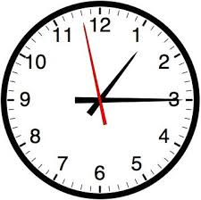
ctime ( ) Function
ctime( ) function returns a char * that references a string with the date in readable form
Argument is the address of a value returned by time( )
The format of the string is: day of week, month, day of month, hour, minute, second, year (www mmm dd HH:mm:ss yyyy\n)
Typical call:
time_t currentTime;
char * timestr;
currentTime = time ( (time_t *) 0) ;
timestr = ctime (&currentTime)
timestr will point to a string like Fri Dec 6 19:00:00 2016

Slide 7

localtime ( ) Function
localtime( ) function returns a pointer to a structure called struct tm (declared <ctime>
Argument is the address of a value returned by time( )
Format of the structure
struct tm {
int tm_sec; // 0 -59
int tm_min; // 0 -59
int tm_hour; // 0-23
int tm_mday; // 1-31
int tm_mon; // 0 -11
int tm_year; // years since 1900
int tm_wday; // 0 - Sunday 1 - Monday... to 6
int tm_yday; // julian day 0 - Jan 1
int tm_isdst; // 1 if daylight savings - 0 if not};
One can access individual members of the struct tm
Note: months in structure are 0-11 not 1-12

Slide 8
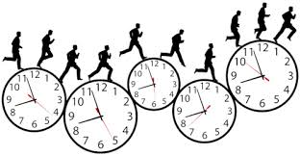
Other Functions
gmtime( ) - similar to localtime( ) but returns universal (Greenwich mean time)
mktime( ) - is the opposite was of localtime( )
Takes a pointer to the tm struct and returns the number of seconds since Jan 1, 1970
Clock() measures of processor time used by program since beginning execution
Value returned is type clock_t (in time.h)
See example time1.cpp

Slide 9
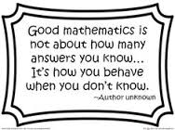
Error Handling in Mathematical Functions
Prototypes for math functions resides in <cmath>
Prototypes for error routines resides in <cerrno>
When an error occurs, the external (global) variable errno is set to indicate the specific error
For example: Domain errors sqrt(-1)
A constant value EDOM (error in domain) is defined in <cerror> and is placed in error to indicate a domain error has occurred
Another example - calculated value is too large (overflow) 800100
pow( ) would return HUG_VAL and ERANGE would be put into errno
See example math1.cpp

Slide 10
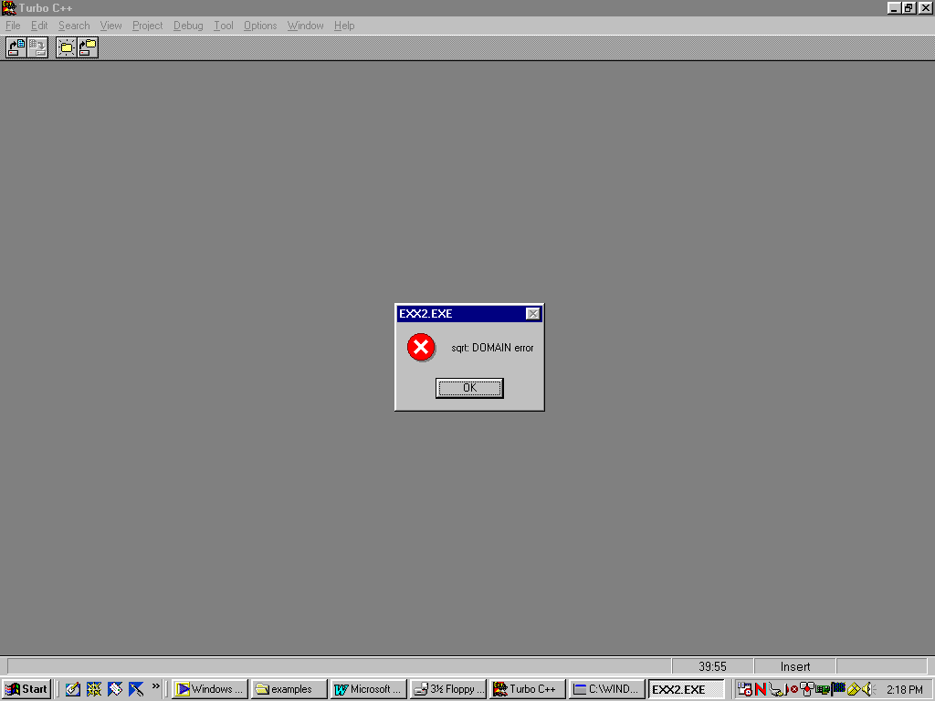
Error Handling

Slide 11

Pointer to Functions
Functions occupy memory locations, so every function has an address, just like each variable has an address

Slide 12

Function Pointers as Arguments (1)
Example: tabulate() is a general function that computes values of various mathematical functions
To use tabulate(), one passes a pointer (address) to the mathematical function as an parameter or argument
A prototype would look like
void tabulate (double(*f)(double), double first, double last, double increment);
The parentheses around *f indicates that f is a pointer to a function

Slide 13

Function Pointers as Arguments (2)
When one calls tabulate, a function name is supplied in the first argument
Note that there are no parentheses after the function name (example: cos)
When a function name isn’t followed by parentheses, the compiler produces a pointer to a function instead of generating a function call
See example fpointer1.cpp

Slide 14
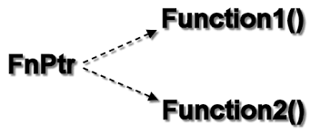
Dereferencing a Function
A function can be invoked by dereferencing
The signature and return type must match
In the following example
pf is a pointer to a function that has takes an int argument and returns a float
See example fpointer2.cpp

Slide 15

Void Pointers
A void pointer is a pointer to a data type that will be specified later
A function can be written to handle a pointer of any data type
The function must know what kind of data that was passed. (pass a flag, etc.)
Once one knows what data type the void pointer references, one must cast it to the pointer of that type. (int *)

Slide 16

Void Pointer Example
int funcVoidPtr(void *type)
{
}
In this case, the function can be invoked using int or floats
funcVoidPtr (&intVar) or funcVoidPtr (&floatVar)
See example (void1.cpp)

Slide 17
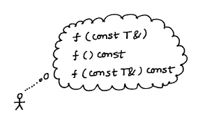
Const Type Qualifier
One needs to be very precise
See examples const1.cpp through const3.cpp

Slide 18
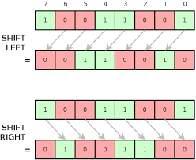
BIT Operations
~ bitwise negation
>> shift right
<< shift left
& bitwise-and
^ bitwise-xor
| bitwise-or

Slide 19

BIT Operations Details (1)
Bitwise operations are usually done with unsigned integers
~expression 0000000000101010 becomes 1111111111010101
expression1 >> expression2
a. both must be ints
b. expression2 > 0
c. expression2 is the number of bits to shift right
d. Any ones on the right are shifted off the end and discarded. The bits on the left are zero-filled.
e. division by 2

Slide 20

BIT Operations Details (2)
expression1 << expression2
a. both must be ints
b. expression2 > 0
c. expression2 is the number of bits to shift left
d. Any ones on the left are shifted off the end and discarded. The bits on the right are zero-filled.
e. multiplication by 2 (unless bits of shifted off)
f. for signed integers, the sign bit might be changed

Slide 21
Logical &
expression1 | expression2 | expression 1 & expression2
ith bit | ith bit | ith bit
1 | 1 | 1
1 | 0 | 0
0 | 1 | 0
0 | 0 | 0

Slide 22
Logical |
expression1 | expression2 | expression 1 | expression2
ith bit | ith bit | ith bit
1 | 1 | 1
1 | 0 | 1
0 | 1 | 1
0 | 0 | 0

Slide 23
Logical ^
expression1 | expression2 | expression 1 ^ expression2
ith bit | ith bit | ith bit
1 | 1 | 0
1 | 0 | 1
0 | 1 | 1
0 | 0 | 0

Slide 24

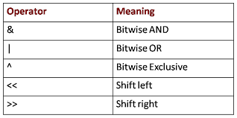
Application of Bit Operators - Using Masks
a. Turn a bit on or off
b. Test a bit
myInt &8 will be false if the fourth bit is 0 and true if 1
myInt=myInt|8 will turn the fourth bit on in the result
xxxxxxxx
00001000
Xxxx1xxx
See bit examples

